Slide 1

Talking Head: Deepfake for Games
Yuming Gu
Jiahui Ding
Hongli Chen
Guangyun Zhou
Chaofan Zhai
Mengyu Zhangan

Slide 2
Framework
1. Background & Goal
2. General Process
3. Future Work

Slide 3
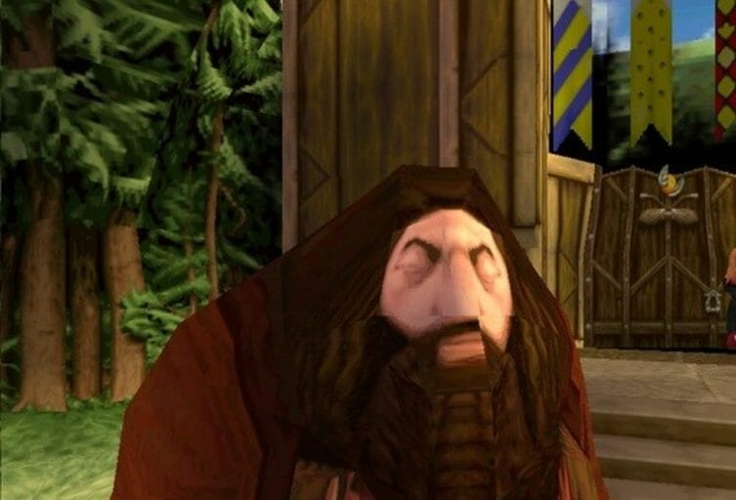
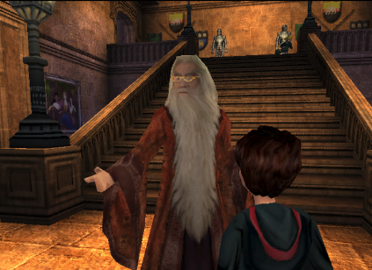
Film-licensed Video Game
Notes:
can you image this is HP's Hagrid and this is Dumbledore
both of this two are from a tie-in game based on HP's movies. The fact is, our markets are full of this low-quality film-licensed video game since they are budget and time sensitive.

Slide 4
Background
The shorter and cheaper development cycles have produced lots of terrible movie-licensed video games.
Investors only want some quick and easy money and game developers do not have freedom for creativity.
Notes:
Our project is aim to help them building high-quality game character model with low-cost and time.
We'd like to
give back freedom of creativity to those video game developers from the hand of Hollywood investor who only want quick and easy money,
give disappointed players their deserved respect
And finally change the long-time low-quality stereotype towards the cinematic-inspired games.

Slide 5
Goal
Reenact a talking figure model of different game characters in a few-shot setting with low cost and less time.
Improve the game character model with more detailed information.
Change the low-quality stereotype of the cinematic-inspired games.

Slide 6
General Process
Mapping Function
Game Character Model
Human face
Human Facial Landmark
Game Character Facial Landmark
Character Face
Human-like Facial Landmark
Human-like
Character Face
Notes:
This is our general process. From human face to our final goal character face. we developed three tracks to gradually achieve it! Let’s go into the first track’s detail.

Slide 7
General Process
Mapping Function
Game Character Model
Human face
Human Facial Landmark
Game Character Facial Landmark
Character Face
Human-like Facial Landmark
Human-like
Character Face

Slide 8
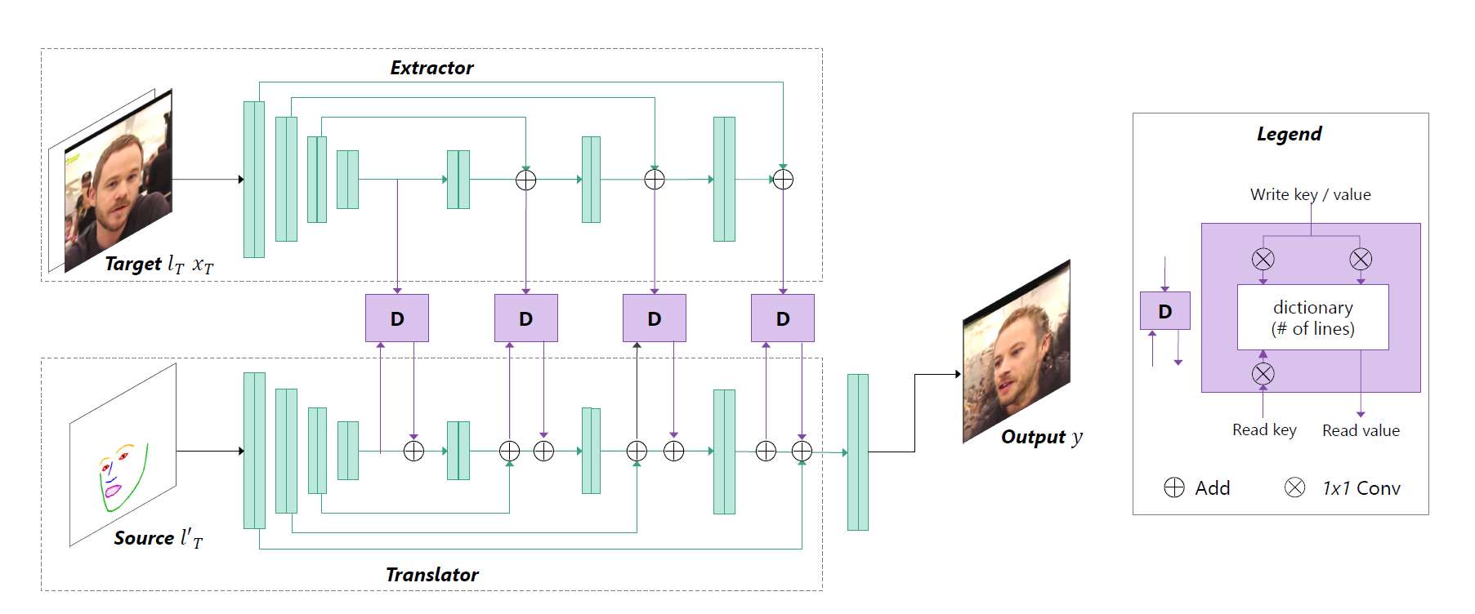
Human Face to Human(like) Face
Notes:
We used a dictionary-based generative adversarial network to translate target image to source image, with the predicted landmarks rasterized as a landmark image which is shown in the source.
We inspired by the Neural Turning Machine to create a read&write based dictionary, for each layer's feature, Target image’s feature will be written into the dictionary and concurrently, source landmark will read the value from the dictionary. and for each part of the source landmark, we want to translate this into "how should it look like", like paste one's identity to landmark skeleton image.l
it still have drawbacks, such like the image quality is not strong enough, and in extreme case such like exaggerated expressions and poses, our method will have highly failed cases. So our team tried more stable methods to deal with it in extreme case. Let my teammate Mengyu to introduce it.

Slide 9
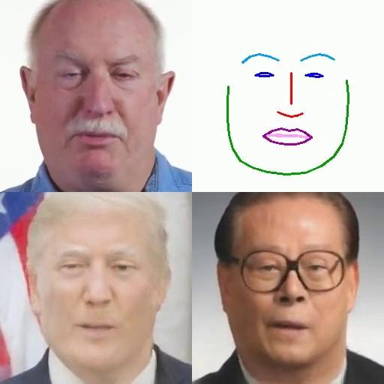
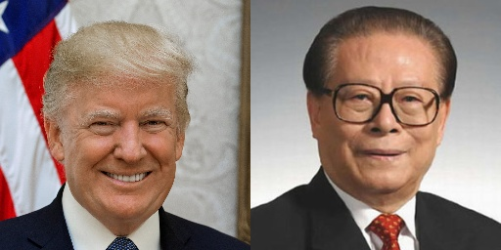
Demo

Slide 10
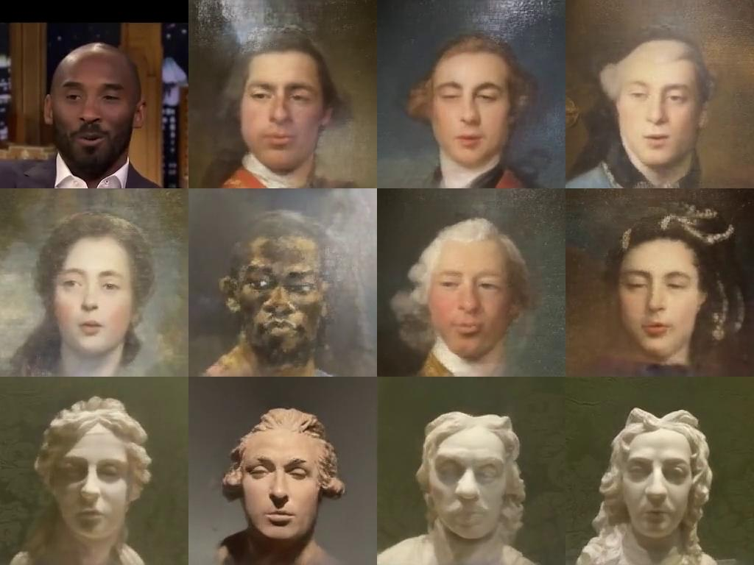
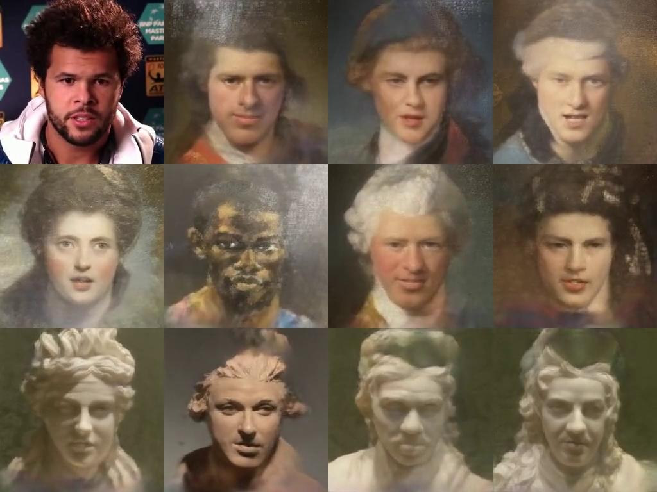
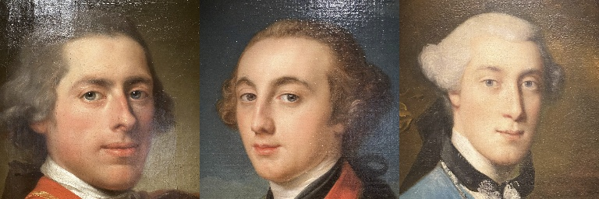
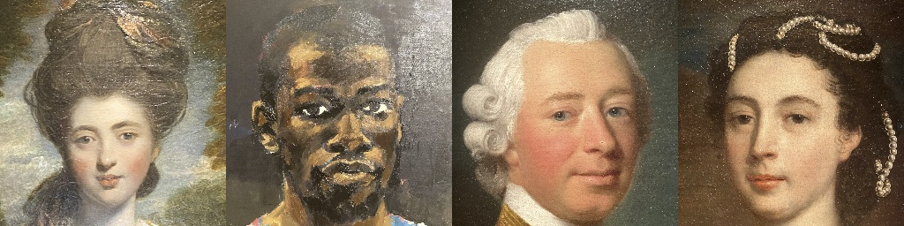
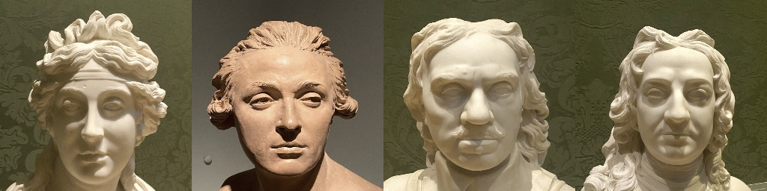
Portrait &
Scuplture
Notes:
it still have drawbacks, such like the image quality is not strong enough, and in extreme case such like exaggerated expressions and poses, our method will have highly failed cases. So our team tried more stable methods to deal with it in extreme case. Let my teammate Mengyu to introduce it.

Slide 11
General Process
Mapping Function
Game Character Model
Human face
Human facial landmark
Game Character Facial Landmark
Character Face
Human-like Facial Landmark
Human-like
Character Face
Notes:
yes, as my teammate mentioned, it has drawbacks. Human face is much different from game characters, so when we applied such model to game characters, it may case some distortion. Also, the work we done with this model are based on 2D pictures and 2D videos. To solve these problems, we tried another method, which works on unity 3D environment and includes more details. This model just maps human face information to game character, and includes a front-end and a back-end.

Slide 12
Human Face to Game Character (Unity)
We introduce a new method with a 3D model including more details
Work in 3D unity enviroment.
Consist of a Front-end(Python) & a Back-end(Unity)
Notes:
yes, as my teammate mentioned, it has drawbacks. Human face is much different from game characters, so when we applied such model to game characters, it may case some distortion. Also, the work we done with this model are based on 2D pictures and 2D videos. To solve these problems, we tried another method, which works on unity 3D and includes more details. This model just maps human face information to game character, and includes a front-end and a back-end.

Slide 13
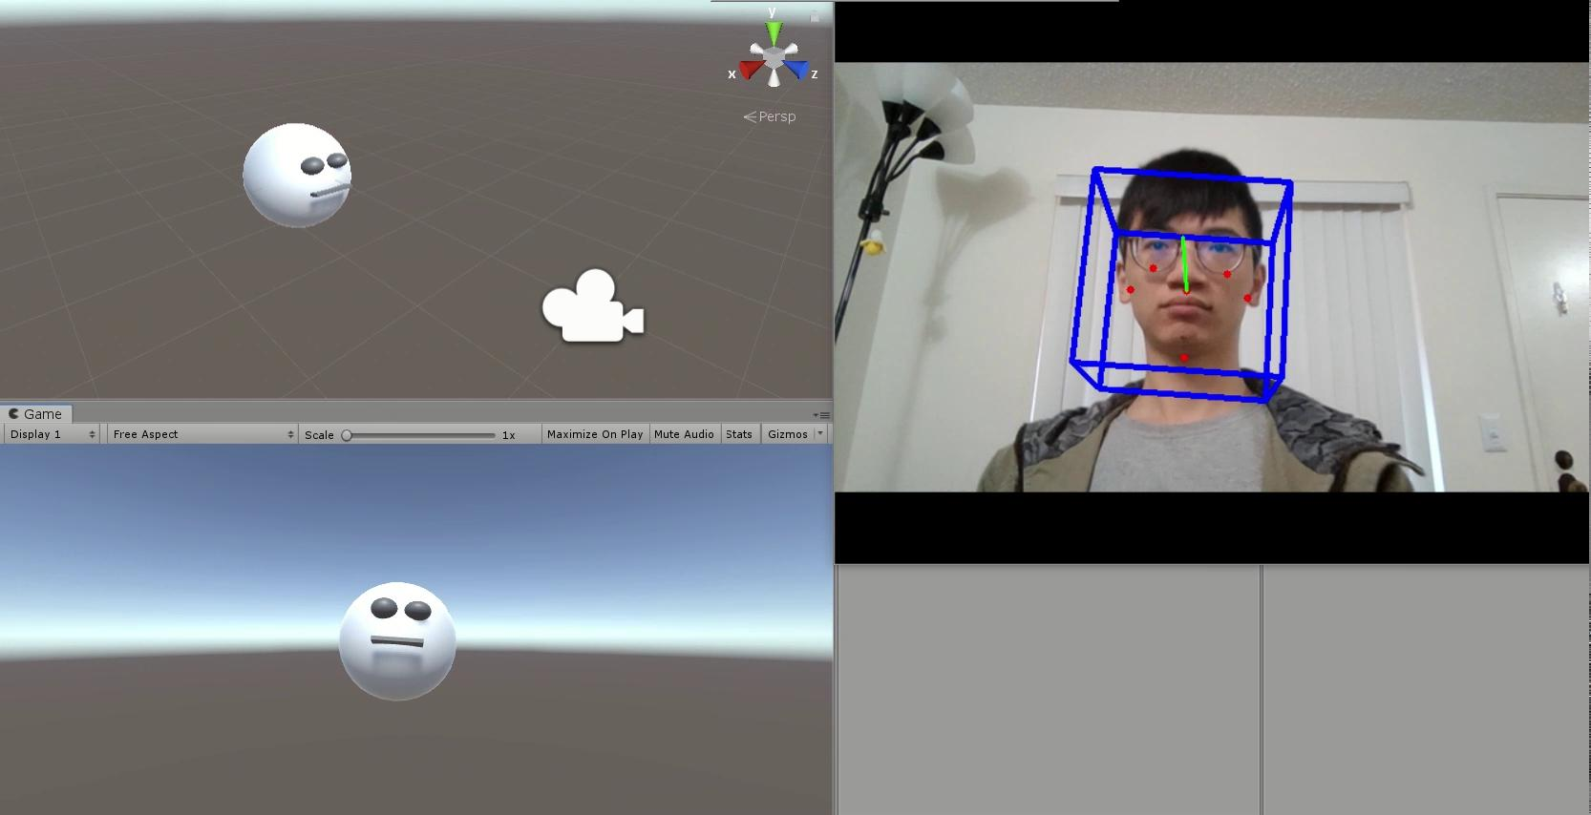
Demo
Notes:
The goal of the program is to estimate the head position, orientation, facial expression and apply them to control the game character. Let’s watch the demo video. The whole program is divided into two parts, landmarks extraction, and mapping functions. OpenCV is used to extract 68 facial landmarks. Then we designed several functions to calculate facial expression features, such as eye blinking. Finally, these features are applied to control the character directly.

Slide 14
General Process
Mapping Function
Game Character Model
Human face
Human facial landmark
Game Character Facial Landmark
Character Face
Human-like Facial Landmark
Human-like
Character Face

Slide 15
Human Face to Game Character (Machine Learning)
Step 1
Step 2
Step 3
Step 4
Build a model that detect game character face position and landmark.
Use the model to generate a large dataset of (game character face, landmark) pair.
Use the dataset generated in step 2 to train a generative model that translate game character landmark to game character face.
Map the human face landmark to game character face landmark.

Slide 16
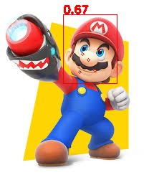
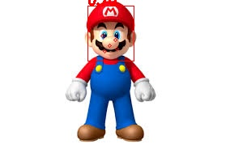
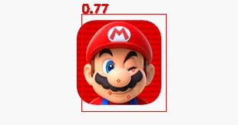
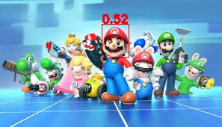
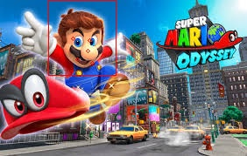
Demo

Slide 17
Human Face to Game Character (Machine Learning)
Advantages
Do not need to build 3D model which need efforts and domain knowledge.
Disadvantages
Need to label a few hundreds of picture as training set.

Slide 18
Future Work
1.Landmark disentangle --- to fit different face
2. From game character landmark to game charachter face
3. Build new game character and improve mapping performance using Unity
4. Compare all ways

